Slide 1

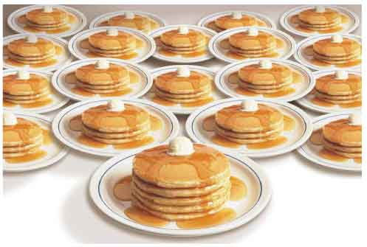
Stack VS Heap Allocation
The secret theme is pancakes

Slide 2
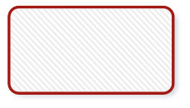

What is a stack?
Two main operations: push and pop
Push
5
Pop 5
Push
35
Pop 35
Push
14
Pop 14
Push
17
Pop 17
Push
1
Pop 1

Slide 3
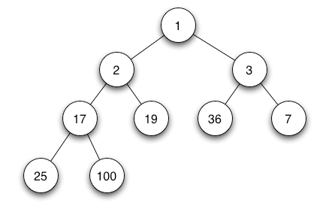
And what about a heap?
This thing?
From Wikipedia

Slide 4
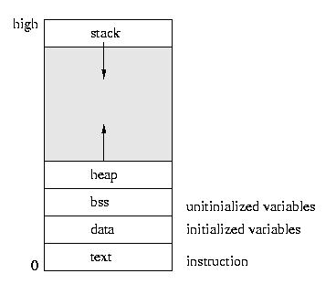
Memory layout
Stack and heap grow in opposite directions
From http://www.andrew.cmu.edu/course/15-440-s12/applications/ln/proccontext.jpg

Slide 5
Why use the stack?
Slightly faster than the heap (usually)
Easy cleanup!
Functional languages only use the stack
Issues:
Stack overflow
Limiting scope

Slide 6
Why use the heap?
More flexible memory allocation and deallocation
With the stack, can only pop in LIFO manner
Heap allows deallocation from any point
Scope of variables is not a concern
Functional languages only use the stack
Issues:
Heap can run out of memory (same as stack)
Need to manually deallocate memory
Memory leaks are possible

Slide 7
Memory hierarchy
Stack
Allocated memory is restricted to the scope it was created in
Automatically deleted when scope is exited
Heap
Allocated memory is not contained in a scope, but rather referenced by a single pointer.
delete or delete[] must be called on the pointer to free the memory
The pointer itself may be (and probably will be) allocated on the stack, so stack rules apply for the pointer itself
If the scope is exited, the pointer is popped and the allocated memory can no longer be referenced, causing a memory leak
Caveat – if another pointer is set to also point to the memory, the data is recoverable

Slide 8
Safe heap-ing
For every use of the keyword 'new', delete or delete[] on the pointer must occur later on!
Otherwise, memory leaks occur
Leak-detection tools such as valgrind are very useful for ensuring your code is leak-free
Keep track of your pointers! Pointers created on the stack are popped of on function exit, so you lost any heap memory it was pointing to

Slide 9


